Slide 1
Sudoku Solvers
By Alice Luce, Adrian Rodriguez, Michael Richards, Jaden Krekow

Slide 2
Project at Present
The focus on a functioning sudoku board is almost complete with implementation of the board generation, UI, hints, and database
More research is being done to understand algorithms such as Bee Colony Optimization and Dancing Links
Fixing any issues we encountered with implementation from last milestone

Slide 3
What’s done
GUI to represent playing sudoku
Basic hint system
Database
Multithreading
Menu

Slide 4
What’s the goal
Create a functional sudoku application that will allow users to generate interact with and solve Sudoku puzzles
Use Sudoku for educational demonstrations visualizing how different algorithms work to solve the board.

Slide 5
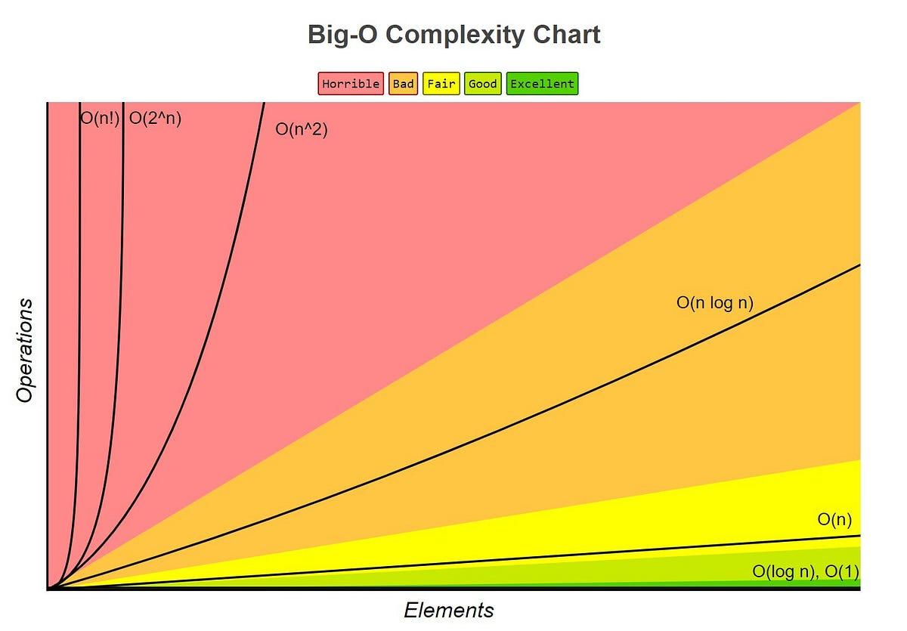
Visualizer
Display to the user metrics related to algorithms
Speed
Effectiveness
Big O Complexity

Slide 6
Tools
PySide 6
Use to design the UI and create an interactable game board that allows user to manually enter information into board cells
SQLite
Used to store board ID, current state of the board, and the solution

Slide 7
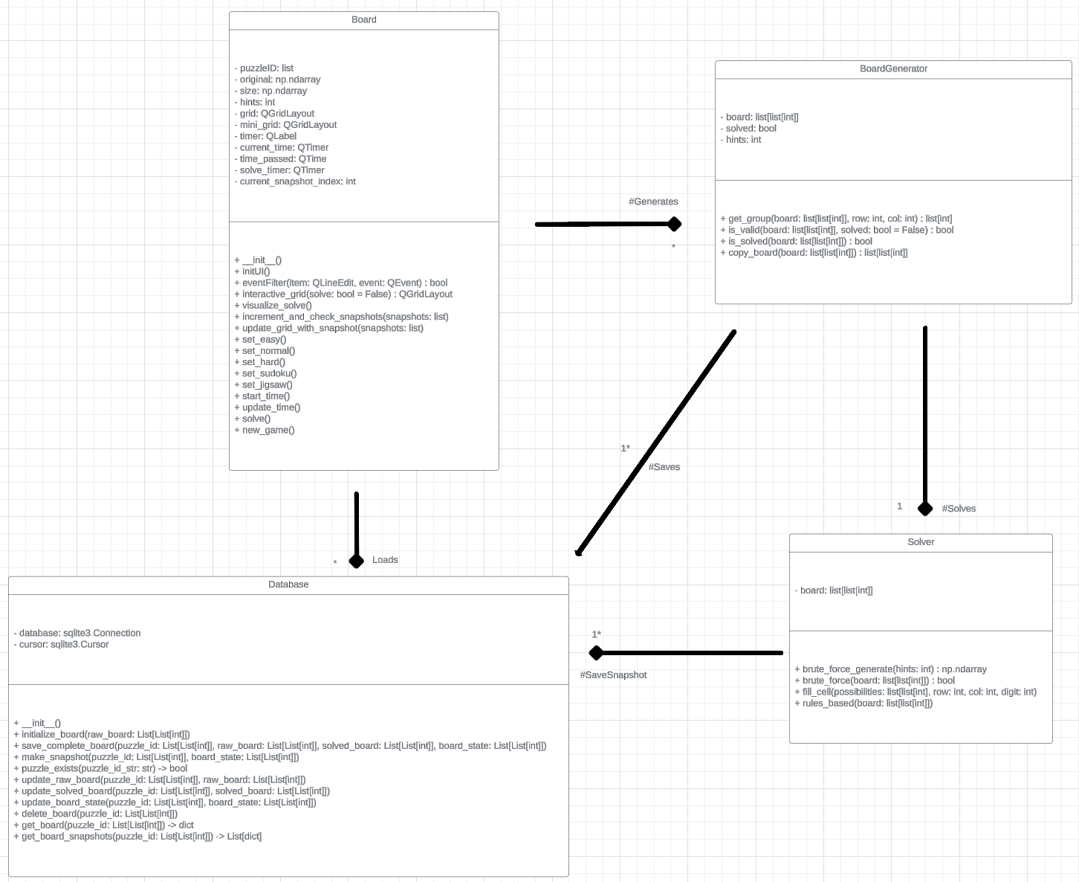
System architecture Diagram

Slide 8
Milestone 4
Task | Alice | Jaden | Adrian | Michael
Database |  | Bug fix | Fixes issues with database saving/loading and link with GUI and Menu
Menu | Implementation of descriptions for each algorithm available and planned to implement. |  | Integrate menu into GUI
Algorithms | Small bug fixes | Implement new solving algorithm | Research new algorithm and help develop and integrate into software | Implement new solving algorithm
GUI | Groundwork for highlighting cells for algorithm visualization. |  | Adding Notes features, enhance hint finding, stylize | Bug fix

Slide 9
Milestone 5
Implement additional algorithms
Analyze runtime efficiency of existing algorithms

Slide 10
Milestone 6
Bug fixes, QA, and user review
Finalize algorithms
Finalize UI

